Slide 1
IPA II CIVIL SOCIETY SECTOR
Monitoring & Evaluation
Findings and Recommendations
Dr. Arda Deniz Aksular

Slide 2

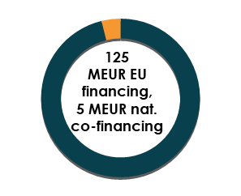



IPA II CIVIL SOCIETY SECTOR*
*Including JMSP and Town Twinning which are actually stand-alone actions.
*Excluding Civil Society projects under direct management.

Slide 3
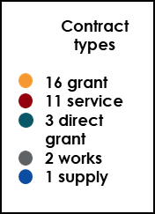
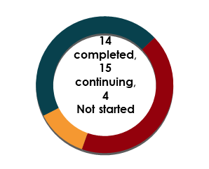
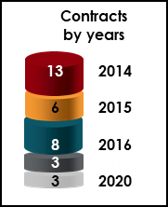
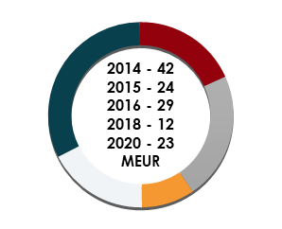
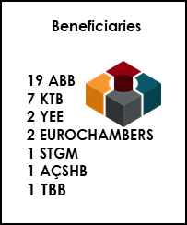
IPA II CIVIL SOCIETY SECTOR

Slide 4

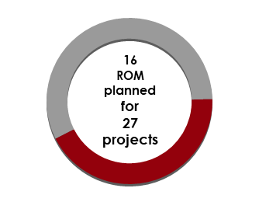
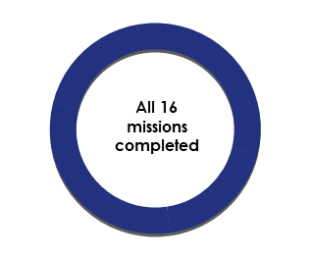
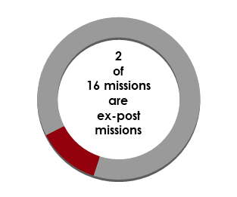
Monitoring Performance*
ROM is the external monitoring system of the European Commission (EC).
Provides recommendations and «external opinion» by focusing on the results.
*Almost all projects within the sector excluding: Not yet started, cancelled, all contracts of continuous projects.

Slide 5

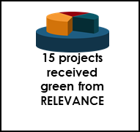
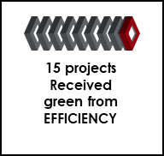
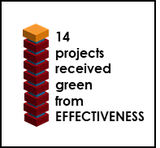
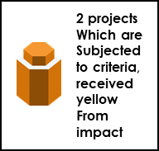

Monitoring Performance

Slide 6
Main Results
Scores of the ROM reports are generally green.
Most successful criterion is effectiveness → the outputs are going to the results.
There is no red score but there are some yellow scores in half of these reports.
The weakest criterion is impact. The second weakest is sustainability.

Slide 7
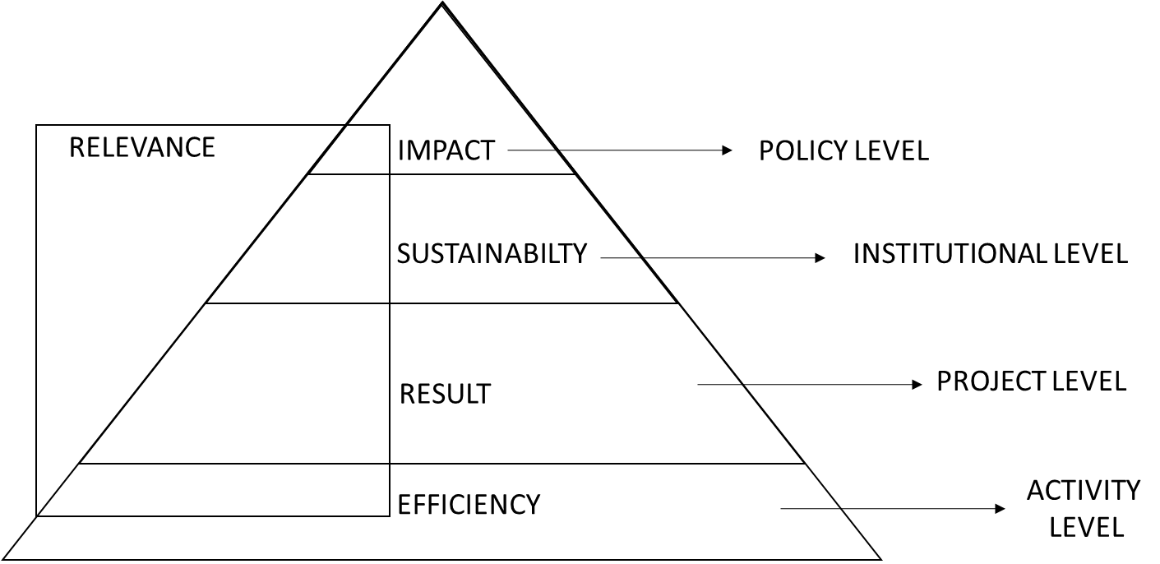
Results & Recommendations

Slide 8
Results & Recommendations
Most CSOs in Turkey do not have adequate financial means to sustain project benefits in the long run.
→ Consider different mechanisms such as Turkish Investment Platform.
Sustainability of the some programmes such as CSD and CSSP, depends on political decision with regard to continuation of these programmes under IPA III (Decentralised system → Centralised system). The dual structure of directly and indirectly managed grants has led to a dual competitive situation among CSOs (EVA*).
Structural issues that should be negotiated with the EU authorities.
One modal or multi level models & better cooperation between direct-indirect management.
No clear framework on long-term cooperation mechanisms between public sector and CSOs.
Better design, cooperation by EU and Turkey institutional level.
* Also reffered in «Ex-post Evaluation of EU Support to Civil Society delivered under IPA 2007 to 2014 in Turkey» project.

Slide 9
Results & Recommendations
CSD programmes are very well known by CSOs but can only be used by a certain group of them due to the highly demanding application requirements (EVA).
→ Simplification of the rules by EU-Turkey level negotiations.
→ Consider building new modalities/micro-level tools for the newcomers. Tools to avoid language barriers.
In some programmes the intervention logics of the grant projects are generally appropriate to facilitate implementation, but baselines for measuring indicator achievement are lacking..
→ Better design, special attention to baselines.
Projects address to capacity development but stress on professionalisation is lacking.
→ Ensure professionalisation in specific areas and sectors through continuity, rather than just improvement of project management capacity.

Slide 10
Results & Recommendations
Lower scores in relevance is related to limited CSO participation in law and policy making processes as well as some design issues at the inception of the project (EVA).
→ Design stronger programmes addressing to policy changes, building legal - administrative capacity.
In many interventions, efficiency of implementation was affected by COVID-19 restrictions; delays necessitated modifications, postponements and cancellations of activities. In most cases project partners adapted efficiently to the new realities (EVA).
→ Consider the potential risks for future programmes despite the decline in COVID.
The coverage of the different provinces has kept considerably declining over the years.
→ Avoid focusing in particular regions-cities.

Slide 11
IPA Issues
PROGRAMMING
PROCUREMENT
IMPLEMENTATION
POST IMPLEMENTATION
Long period between programming-implementation. Approx: 4 years…
Inflexible process (centralised system is more flexible, financial rules are strict, hard to implement simplified cost option)
Referring to cross cutting issues: environment, climate change, gender, digitalisation.
(decreasing paper work, increasing online tools etc.)

Slide 12
THANK YOU!

